Slide 1
Install linux and python on your laptop

Slide 2
Why linux?
linux is an operating system, just like OS X or Windows, and it is very common on big computers like workstations, servers, and supercomputers.
You can “talk” to linux by typing commands in a terminal, and these can do everything you do graphically by pointing and clicking on your laptop.
You can also use linux on your laptop, and so it is a convenient “universal language” to operate across any system without needing a cumbersome graphical desktop.
In this class you will learn enough linux commands to make it really useful.

Slide 3
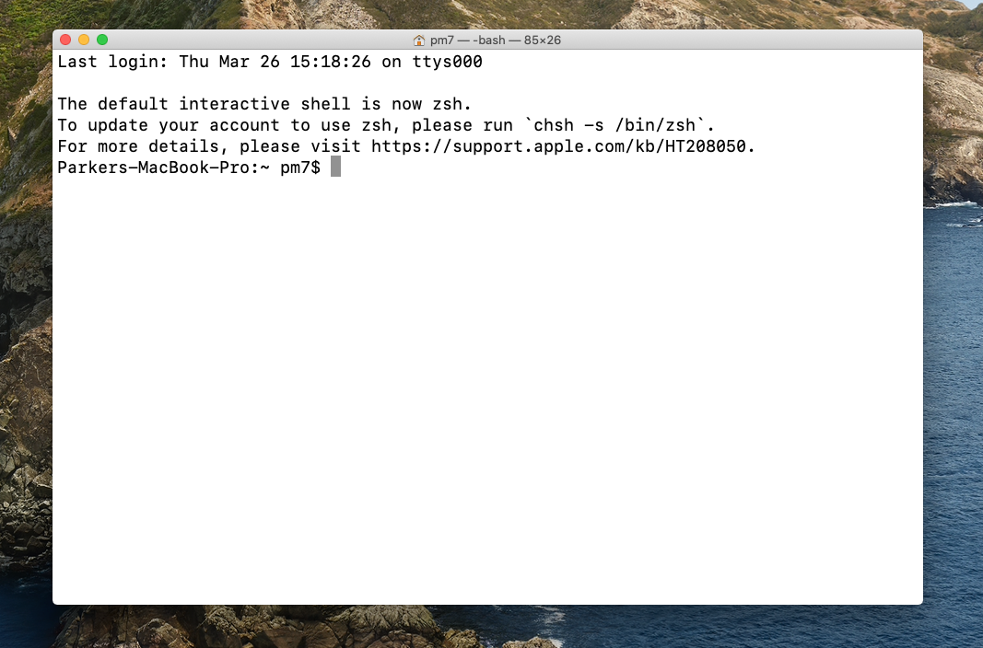
Installing linux on your laptop: mac
If you use a mac then your operating system (OS X) is already built on top of linux.
Go to Applications/Utilities and click on Terminal, which brings up something like this:
Right-click on the Terminal icon in your toolbar and select Options/Keep in Dock so it is always convenient to open
For this class we will use the “bash” shell (a shell is just the interface between you and linux – they are not very different)
To see which shell you are using type:
echo $SHELL
To set your shell to always be bash type:
chsh -s /bin/bash

Slide 4
Windows version – a bit more work...
Please See the "Install linux and python for Windows.pdf" which can be downloaded from the course web page.
This will get you both linux and python (installed in linux).

Slide 5
Get python 3 for your laptop
I like the Anaconda distribution of python because it is tailored for scientific users, and I use python 3 because it is a good idea to use the most recent distribution of any software.
Start here https://www.anaconda.com/
Choose the python 3.7 (or most recent), 64 bit version, and use graphical installer for Mac or Windows
I put it in /Applications on my mac.
After you have done this you may notice that “(base)” appears in your prompt in the terminal window. This is telling you that you are in the default python “environment”. In Anaconda you can make other environments which allow you to have different collections of python modules available. Using environments is a really good idea if you need to write code that relies on certain modules, but it also adds a bit to the mental overhead, so for this class we will ignore it.

Slide 6
Finishing your python installation
Completing the installation, do (from the command line):
conda update --all (two dashes)
For other modules I first issue the command:
conda config --add channels conda-forge --force
What this does is make sure conda looks in a place called conda-forge for the other modules you install. Then I install a few other modules that are not included with the default anaconda package. Do this from the command line, e.g. to install the seawater routines:
conda install seawater
And then repeat the “conda install” step for gsw (Gibbs seawater routines), cmocean (the awesome ocean-oriented colormaps), and netCDF4 (for opening or creating NetCDF files).
Occasionally you also have to use “pip” to install a package, e.g.:
pip install PyCO2SYS (based on guidance from https://github.com/mvdh7/PyCO2SYS)
Other useful commands:
conda list (this will list all packages, even if they were installed by pip "pypi")
conda remove [package_name]
pip freeze (similar to conda list)
sudo pip install [package_name] --upgrade
A full guide to such things is available from the always-awesome Anaconda:
https://docs.conda.io/projects/conda/en/latest/user-guide/tasks/manage-pkgs.html

Slide 7
First steps with linux
Open a terminal window and type “pwd” (you don’t type the quote marks)
This is short for “print working directory” and it will tell you the “path” to where you are.
You can get to any other directory on your machine by typing
cd [path]
(cd = change directory) and [path] is something like /Users/pm7/Documents.
Exercises:
Find the path to your Documents and Downloads.
Where are you after you type “cd ~”? This is what is called your home directory, and it is where environment settings are hidden.
List the contents of a directory using “ls”

Slide 8
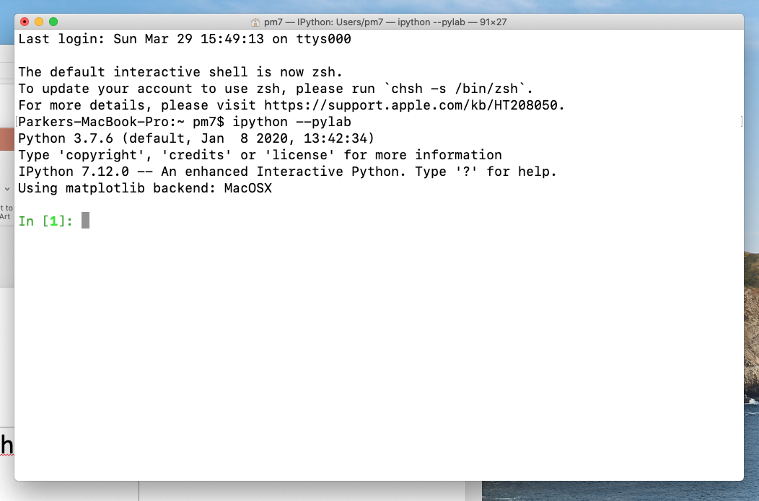
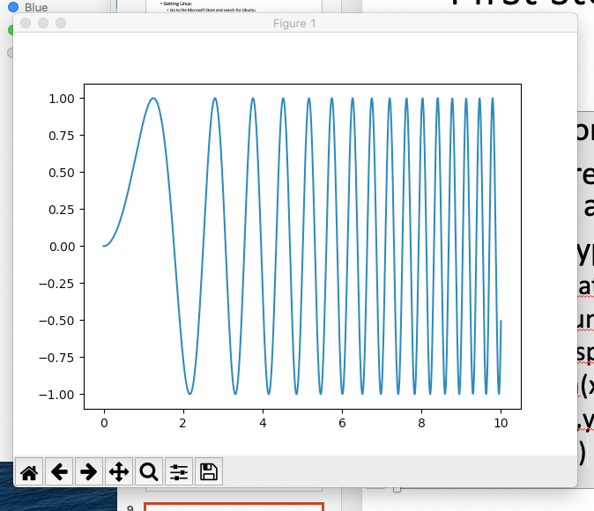
First steps with python
From the command line type “ipython --pylab” (two dashes)
Now you are in an environment where you can issue python commands and see the results
Exercise, type:
import matplotlib.pyplot as plt
import numpy as np
x = np.linspace(0,10,1000)
y = np.sin(x**2)
plt.plot(x,y)
plt.show() # maybe not needed
If all is working as hoped, you should get a new window the looks like this =>

Slide 9
Finally, get an account on a remote linux machine
When we did the course in Spring 2020 I had students get an account on my linux machine “fjord” which you may see mentioned in subsequent lectures.
You can’t do this, so ask you local system administrator instead.
Throughout the course I stress the importance of developing code that can readily be run both on your laptop and on a remote machine.

